Slide 1
DATA ANALYTICS AND COGNOS
Product sales Analysis
SUBMMITTED BY
THIYANESHWARAN L

Slide 2
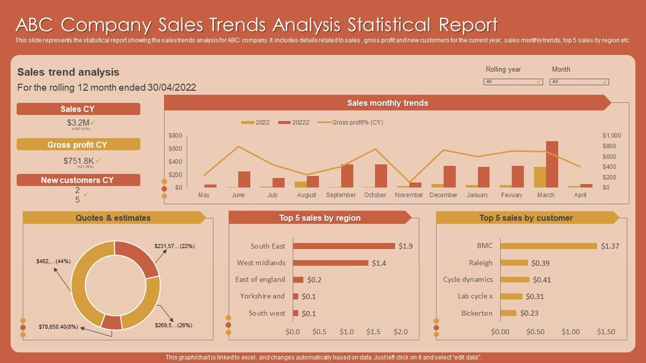

Slide 3
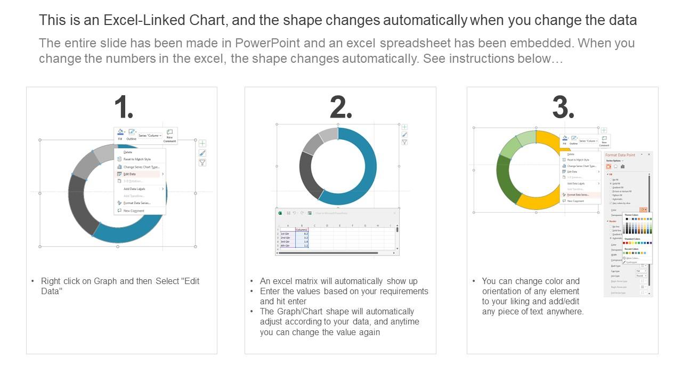

Slide 4


Slide 5
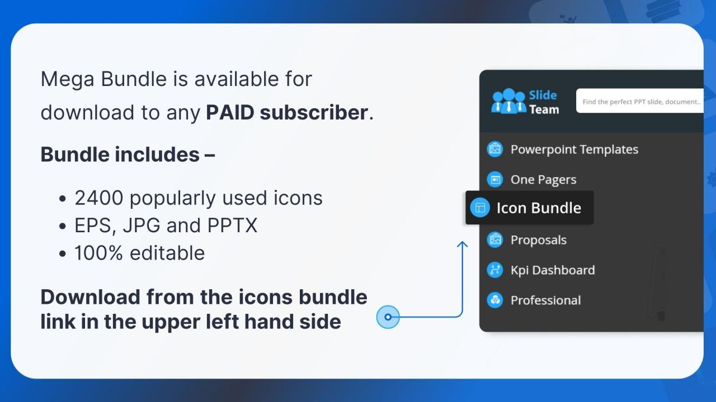

Slide 6
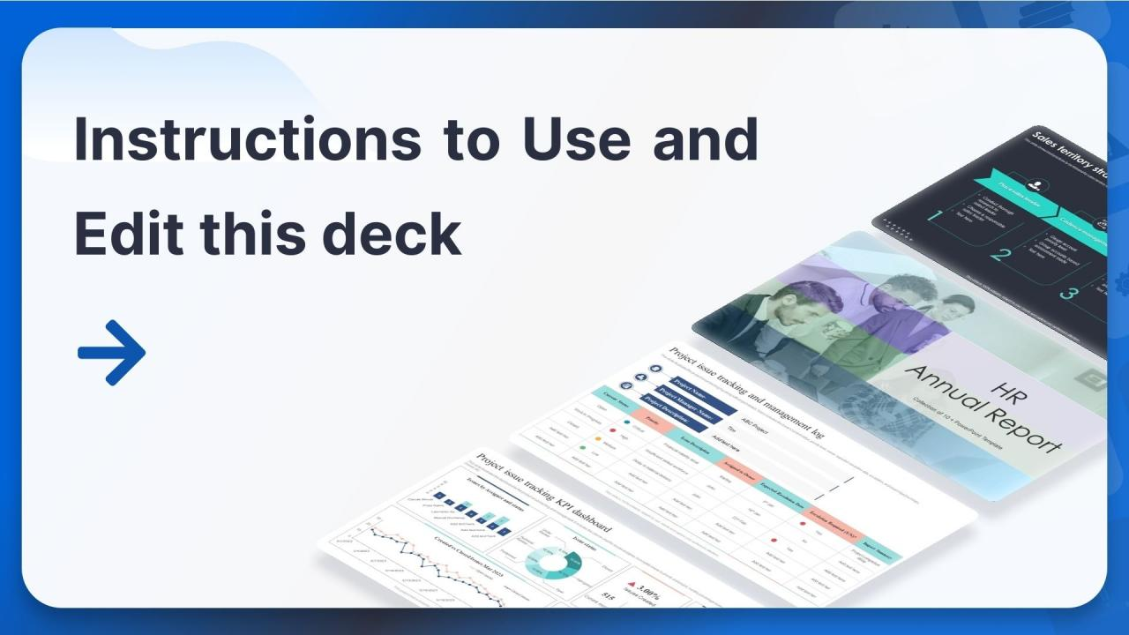

Slide 7
